Slide 1
[CALTOR]
ENSE 400
BI-WEEKLY SCRUM REPORT-OUT
EARL JEDRICK MACALINO
UMANGI PATEL
GLAIZA REGONAS
[OCT 11, 2019]

Slide 2

PROJECT DEATS
Remind me what you are doing
What problem(s) are you trying to solve?
To upgrade the Grading Calculator for the Academic Transition Program in UofR.
What gap are you filling?
To have a proper and reliable calculator that is catered to their needs and requirements.
What innovation are you creating?
A web page that will act as a tool to help students keep track of their grades.

Slide 3
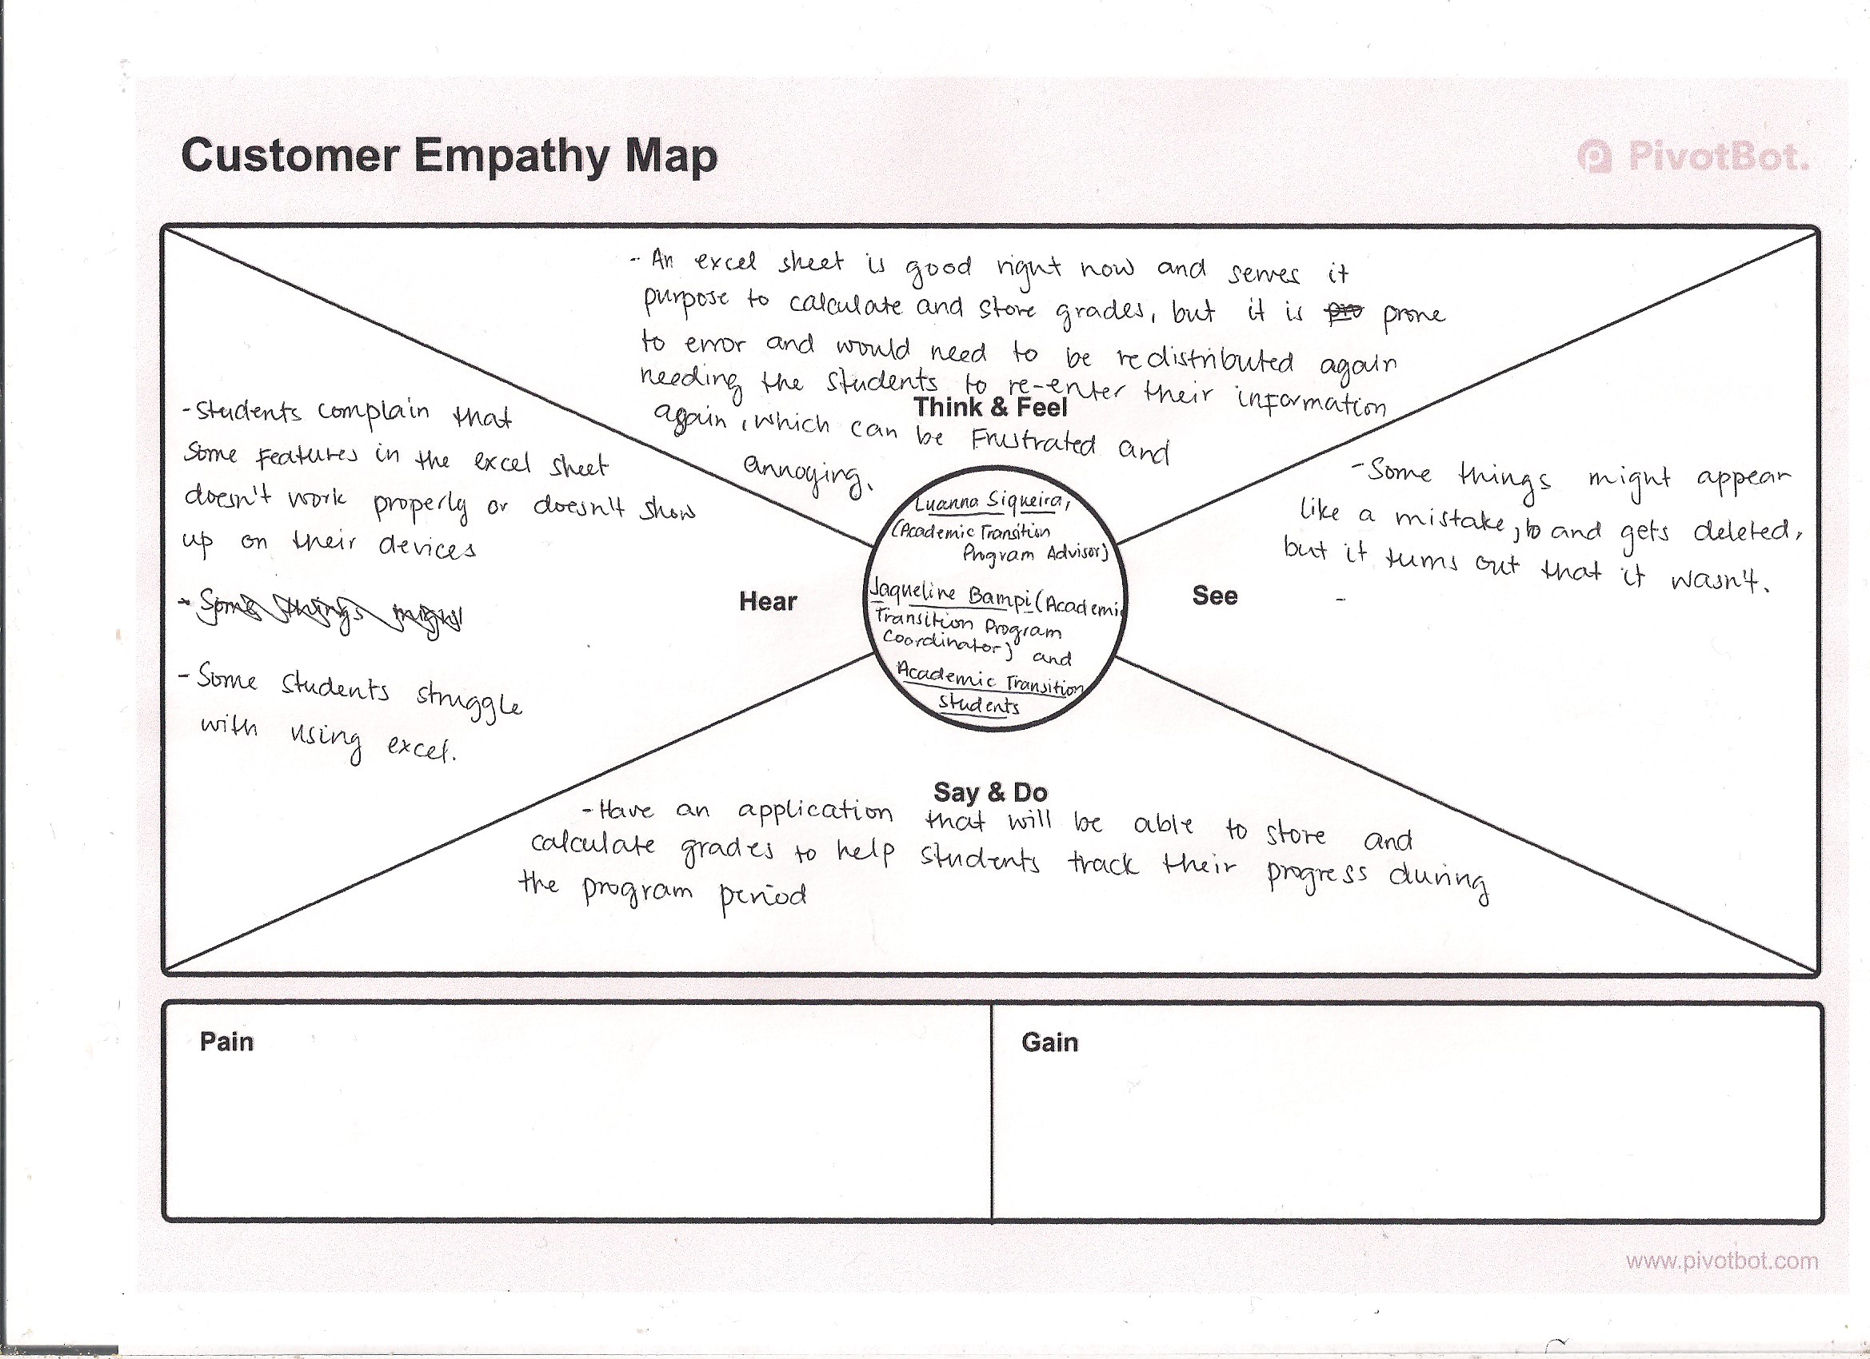
Vision, Rationale, Stakeholders (Empathy Map)

Slide 4
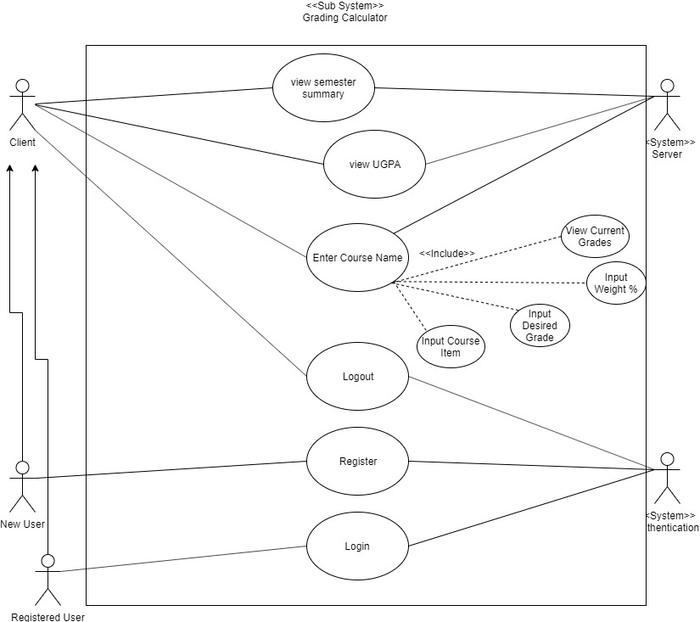
Use Case Diagram

Slide 5
Constraints and Function Requirements
Functional requirements
The Grading Calculator must be able to:
Have user signup and log in
Stores user’s inputs (assignment grades, grades from previous classes)
From those stored data be able to calculate the user’s UGPA according the University of Regina standard
Have those data and calculations saved when the user logs back in so that they don’t have to keep entering their grades
Have a different section for the Academic Transition Program class
Be able to also be used by other students not just the ones in the program
An academic plan that will help student plan out their future classes.
Constraints
Users will need to enter their previous grades in order to determine their UGPA and store it in the database.
Not free to design what we want; we must constantly meet with the stakeholders for them to approve every step with make.

Slide 6
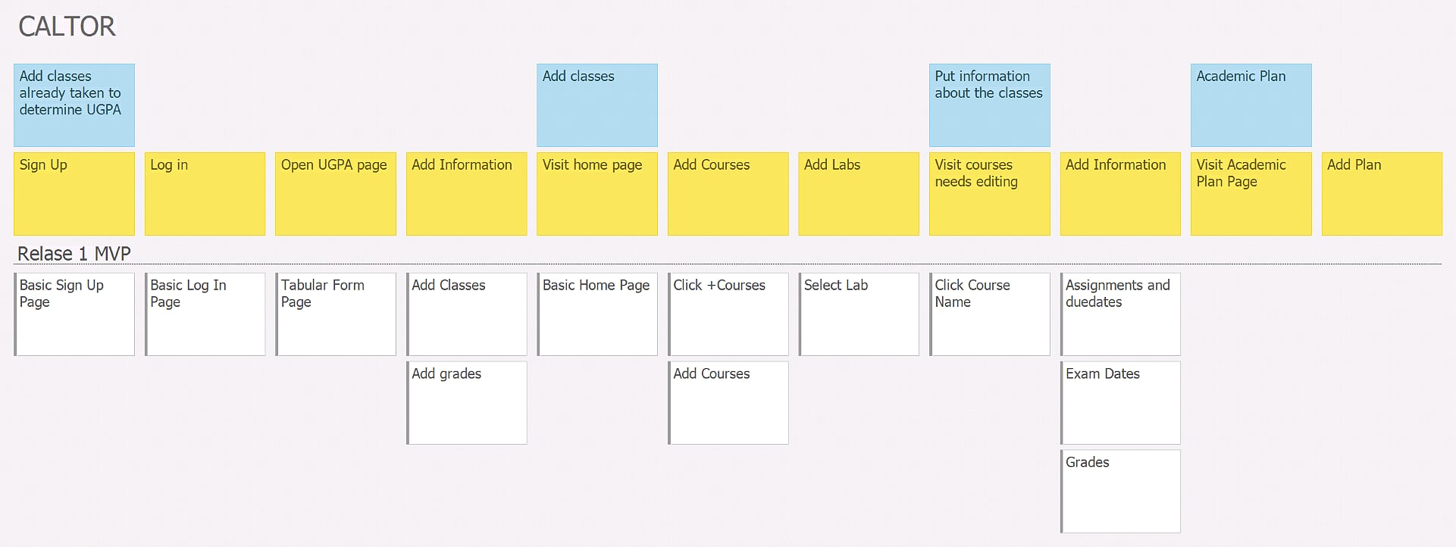
StoriesOnBoard

Slide 7
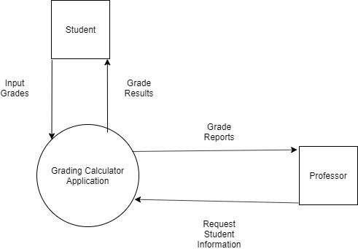
Context Diagram

Slide 8
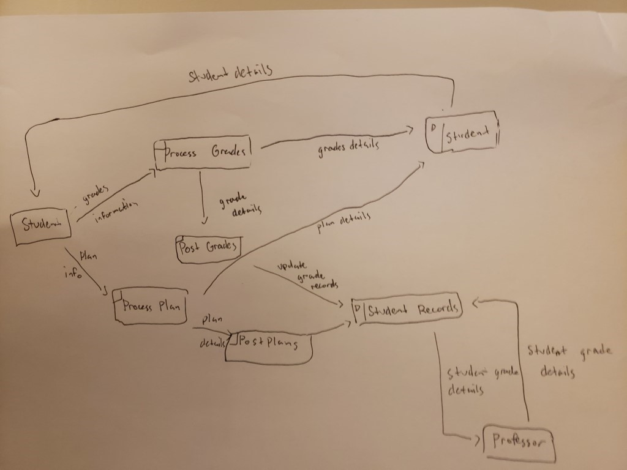
Dataflow Diagram

Slide 9
Balsamic

Slide 10
PROJECT & DOCUMENTATION REVIEW
Program Language used: ASP.net
Testing plans/work
Code: Unit Testing implemented in ASP.net
Usability : Beta Testing with the students in the Academic Transition Program
Deployment/change management plan/work
Maintenance & refactoring plan/work
No maintenance needed once done the project.

Slide 11

GitHub/Version control “stamp of approval”
GitHub:
ttps://github.com/regonasg/Capstone-Project

Slide 12

GROUP REFLECTION
Do you feel you are on track?
Yes
Do you feel there are barriers to your success (if any)?
Needing to have Luanna and Jaqueline's approval in all the steps that we take.
Using a new programming language
Do you need any help going forward?
Any other questions or concerns?
How do we do Logic Data Model on the Function Requirement Diagram?

Slide 13
IMAGE REFS
Show me what you got, https://pictures.abebooks.com/isbn/9781548899530-us-300.jpg
Patrick, https://imgflip.com/memetemplate/43274976/spongebob-patrick-nail-saw
Dilbert, http://4.bp.blogspot.com/-tVbJsudDNaw/T29WxQ0PHZI/AAAAAAAAABc/UlTwD2gkzA4/s1600/Dilbert%2520Software%2520Demo%5B1%5D.jpg
Pondering, https://imgflip.com/s/meme/Question-Rage-Face.jpg
Seal of Approval, https://www.instructables.com/id/How-to-Make-a-Quality-Meme/
Empathy Map Template, https://medium.com/pivotbot/the-customer-empathy-mapping-toolkit-1f7bc6ed8571

